Slide 1
Drop Shipments and Special Orders in Business Central

Slide 2
Speaker
Steven Chinsky – Microsoft MVP
Director Dynamics Practice
schinsky@accelerynt.com
774-254-1185
Advanced Credentialed Professional
Microsoft MCP
NAVUG/BC All-Star
4-Time Granite Award Recipient
Guardian Award Recipient
Chair Emeritus Summit
DUG and Summit Programming Committee Member
NAVUG/BC Board of Advisors
New York and Boston Chapter Leader
24 years NAV/BC experience
16 years Accounting, Operations, and Auditing experience

Slide 3
Agenda
Definitions
How do I use Drop Shipments?
How do I use Special Orders?
Demo
The Largest Independant Gathering of the Microsoft User Ecosystem

Slide 4
Definitions

Slide 5
Definitions
Drop Shipments
A Drop Shipment is a shipment of an item or a consignment of items from one of your vendors directly to one of your customers.
Special Orders
A Special Order allows you to create a purchase order for specific nonstock items the vendor ships to your warehouse that is then shipped to your customer.

Slide 6
Definitions
Comparison:
Action | Drop Shipment | Special Orders
Requires setup to create Purchasing Codes | YES | YES
Links a Purchase Order directly to Sales Order | YES | YES
Can use Requisition Worksheet to create Purchase Orders | YES | YES
Allows for inventory to be verified by warehouse personnel before receiving and shipping the material | NO | YES
Automatically posts the Receipt of Goods when Posting Shipment to Customer | YES | NO
Prevents recording liability until after shipment of material is processed | YES | NO

Slide 7
How do I use
Drop Shipments?

Slide 8
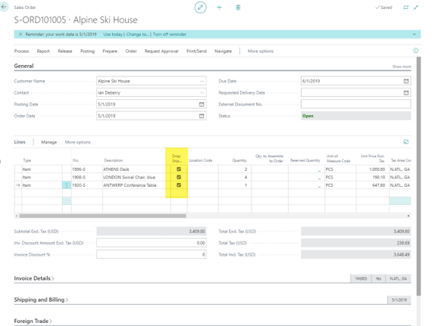
Drop Shipment Steps
Create Sales Order but make sure you check the box for Drop Shipment
This check box isn't showing out of the box, so you'll have to personalize your page. TIP: use Profile (role) to personalize so it affects all users within that role and then each user won't have to personalize their own page.
Once your Sales Order is created, you'll move onto creating a Purchase Order.
Notes:
Purchasing Codes = Drop Shipment

Slide 9
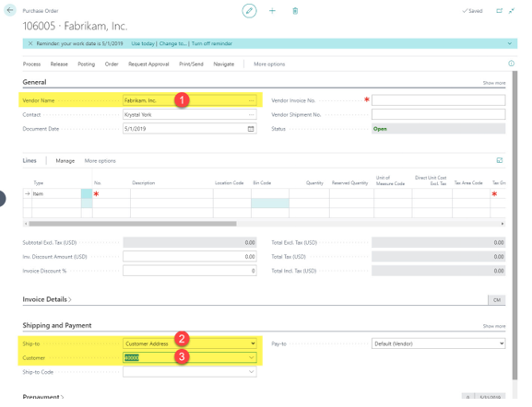
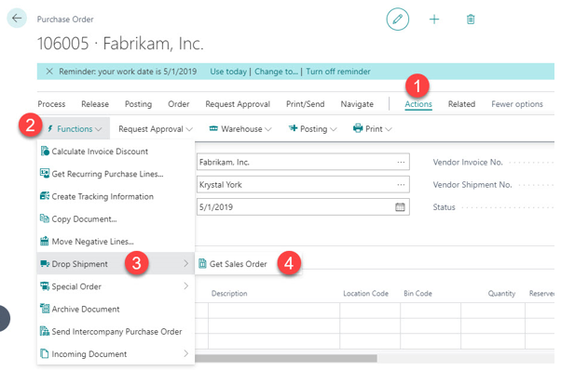
Drop Shipment Steps
Create a new Purchase Order. On the Shipping and Payment Fast Tab add the Ship-to = Customer Address and then Customer = Customer from Sales Order.
Let’s add some Purchase Lines from the Sales Order. Click Action/Functions/Drop Shipment/Get Sales Order
Notes:
Requisition Worksheet does this too

Slide 10
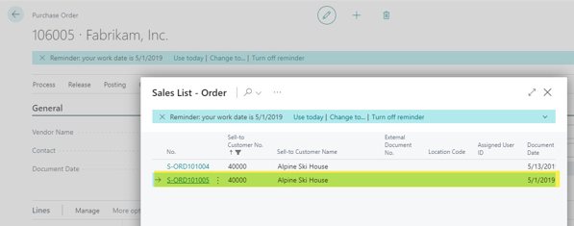
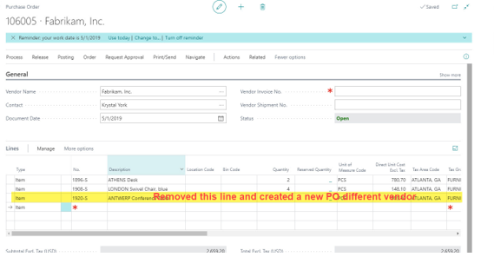
Drop Shipment Steps
Select the correct Sales Order, from the Sales List – Order page
Review the lines on the Purchase Order and remove any lines that may need to go on another Purchase Order for another vendor.
Once the vendor emails you and invoice and confirms shipment has been completed, you can return to the Sales Order to Post-Ship.
After you complete the Post-Invoice, on the Sales Order, you can enter the Vendor Invoice against the Purchase Order.

Slide 11
How do I use
Special Orders?

Slide 12
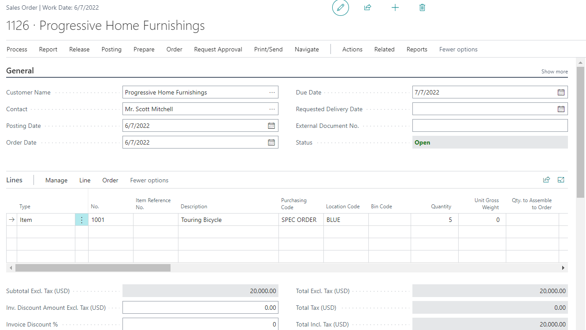
Special Order Steps
Create Sales Order but make sure in the Purchasing Code field, on the Sales Line, you select Special Order.
Once your Sales Order is created, you'll move onto creating a Purchase Order.

Slide 13
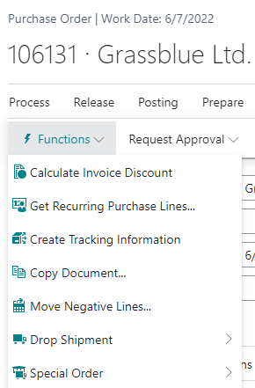
Special Order Steps
Create a new Purchase Order. On the Shipping and Payment Fast Tab add the Ship-to = Customer Address and then Customer = Customer from Sales Order.
Let’s add some Purchase Lines from the Sales Order. Click Action/Functions/Special Order/Get Sales Order
Notes:
Requisition Worksheet does this too

Slide 14
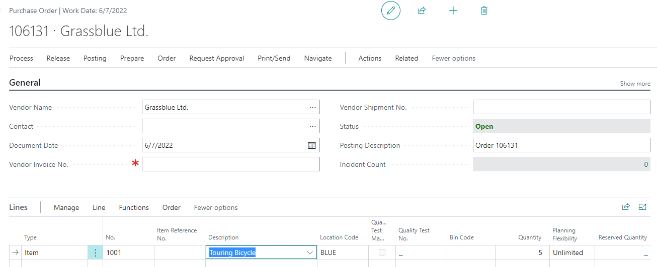
Special Order Steps
Select the correct Sales Order, from the Sales List – Order page
Review the lines on the Purchase Order and remove any lines that may need to go on another Purchase Order for another vendor.
You now can Receive the Special Order off the Purchase Order into the Warehouse and then Ship the Sales Order.
Notes:
NEXT SLIDE DEMO

Slide 15
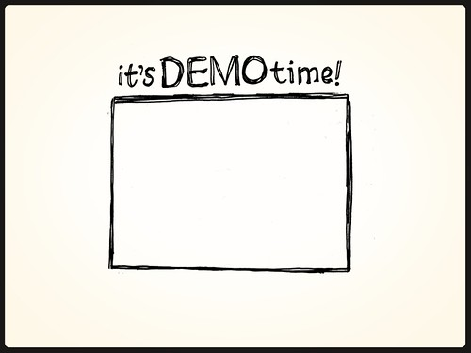

Slide 16
Thank you for
Attending!
schinsky@accelerynt.com

